Slide 1
Experimental Evidence on the System of Rice Intensification
Christopher B. Barrett, Asad Islam, Abdul Malek, Deb Pakrashi, Ummul Ruthbah
Seminar at Stanford University Center on Food Security and the Environment
March 2, 2020

Slide 2
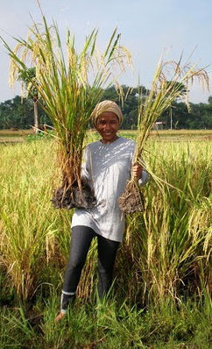
Specific Motivation: SRI Controversy
System of Rice Intensification(SRI) began in 1980s Madagascar.
Now diffused to >50 countries.
Shows big (30-80% yield/profit) gains in observational data.
But diffusion remains limited within countries and disadoption surprisingly high (often 15-40%).
Gains also remain hotly disputed within rice science community (e.g., “Curiosity, Nonsense Non-science and SRI” or “Agronomic UFOs” both published in Field Crops Research).
To date, despite >1200 journal articles on SRI to date, no RCT to evaluate diffusion or farmer-managed gains.
We (w/BRAC) fielded 1st large-scale, multi-year RCT on diffusion of/gains from SRI in Bangladesh.
We find significant gains but high disadoption rates.
Photo credit: SRI-RICE
http://sri.ciifad.cornell.edu/

Slide 3
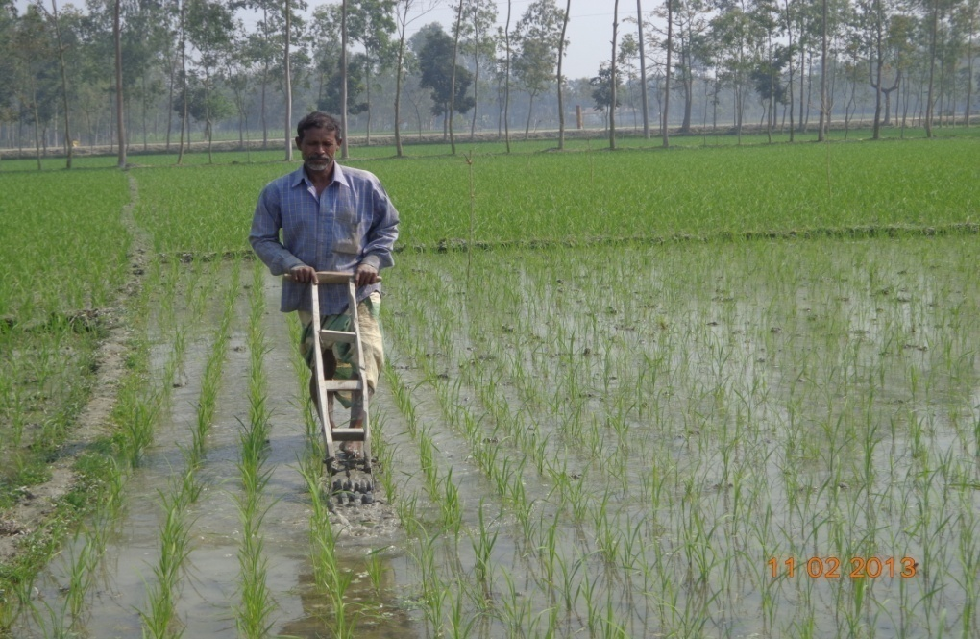
Broader Motivation: Learning in Ag Tech Adoption
Returns to new technologies are uncertain and endogenous to farmer behavior.
Core economics models (Foster & Rosenzweig 1995, Conley & Udry 2010, etc.) rely on farmer learning about a single, performance-related object … typically the profit function.
But these models have two central predictions:
Performance improves with added information/learning. Adoption is just a stop along the way.
Disadoption should never happen.
Newer alternative models (Gabaix, Hanna et al., Schwartzstein, Nourani, etc.) focus on multi-object learning and selective inattention, which may be better for SRI and other complex practices. Maybe learning whether to try a new tech differs from learning how to use it?
We find greater intensity of exposure to SRI increases adoption as well as performance at the extensive margin. But not performance at the intensive margin. Also high rates of disadoption. More consistent with multi-object than single object (e.g., target input) learning models.

Slide 4
SRI
A locally adaptable system of rice cultivation practices/principles.
No purchased inputs required, thus often thought to be pro-poor.
Key principles consist of the following (1st 3 are the distinctive ones):
Early transplanting of seedlings
Transplanting in wider spacing
Just one or two seedlings/hill
Intermittent irrigation (Alternate Wetting and Drying, AWD)
Complementary weed and pest control
Incorporate organic matter into soils
Some agronomists consider these simply best management practices (BMPs): promote healthy seedlings, full use of organics, regular plant deometry, judicious use of water, good weed control … these develop robust root system, and ensure adequate nutrient and water availability.

Slide 5
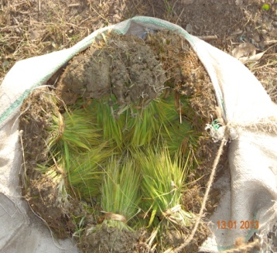
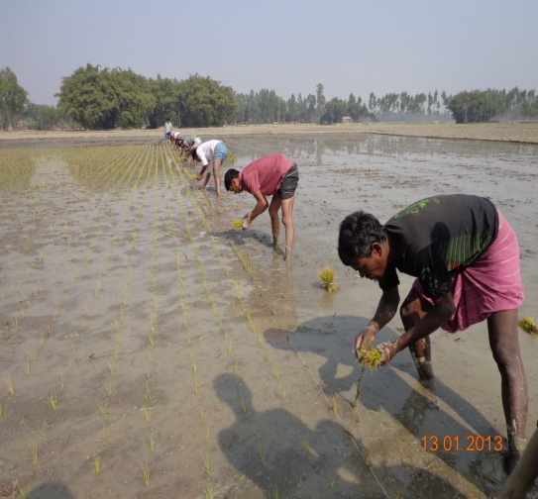
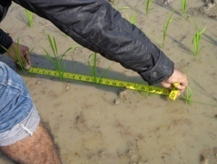
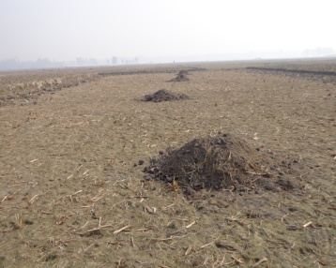
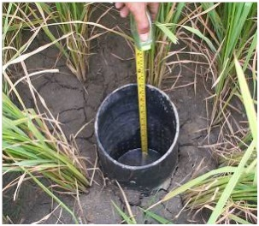

6 key SRI principles taught by BRAC
15-20 days-old seedlings
One or two seedlings per hill
Wider spacing (25 × 20 cm)
Use more organic fertilizer
Alternate wetting and drying for irrigation
Mechanical weeding at regular intervals

Slide 6
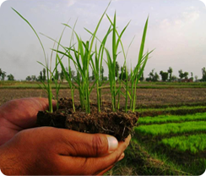
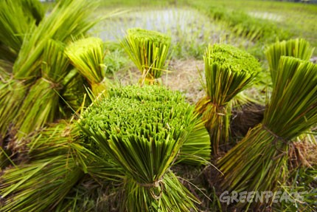
1. Age of seedlings at transplanting
SRI vs traditional methods: 6 key principles
SRI
Traditional Method
Younger (15-20 day) seedlings
Older (40-45 day) seedlings

Slide 7
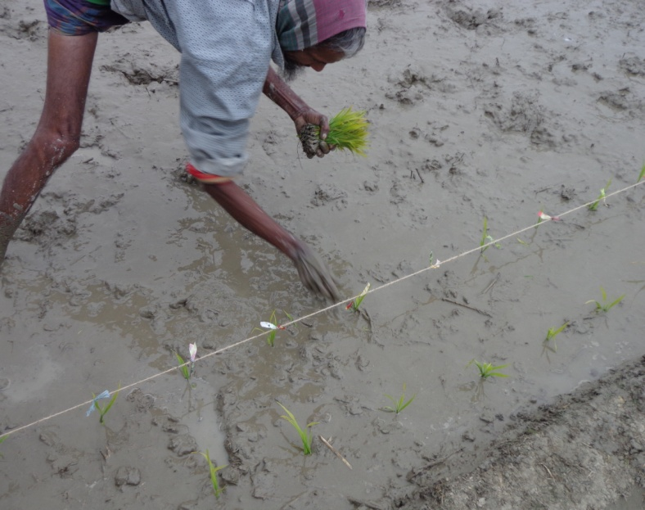
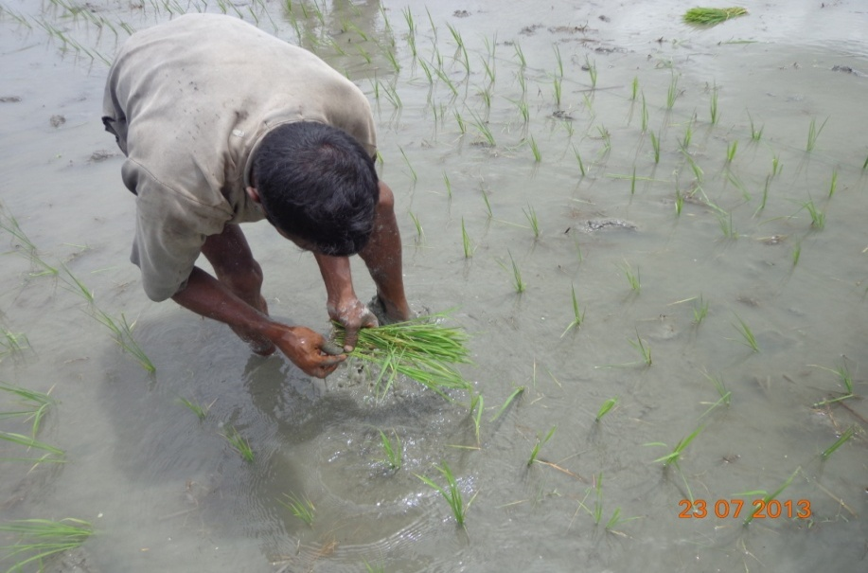
2. Number of seedlings per hill
SRI vs traditional methods: 6 key principles
SRI
Traditional Method
1-2 seedlings per hill
4-5 seedlings per hill

Slide 8
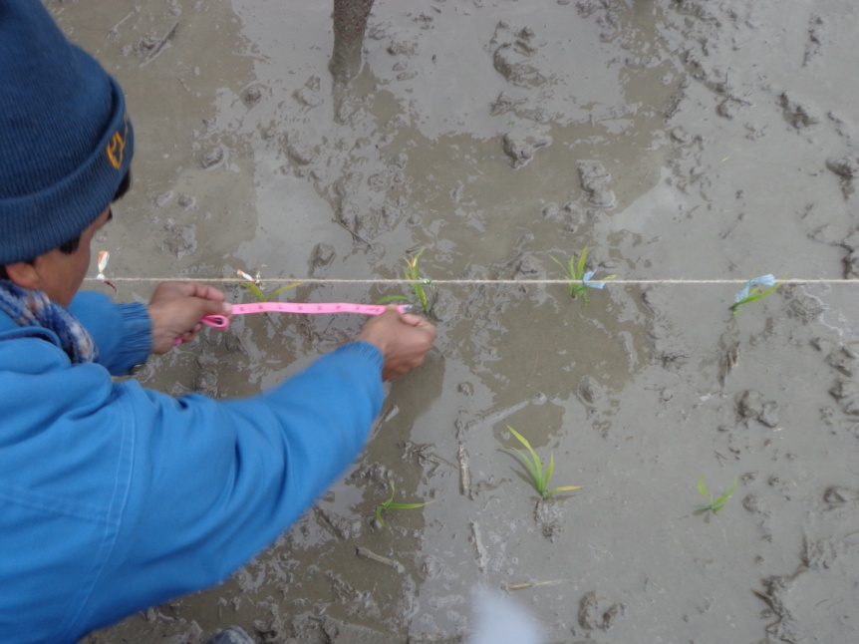
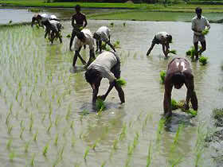
3. Transplanted seedling spacing
SRI vs traditional methods: 6 key principles
SRI
Traditional Method
Specific distance (25 × 20 cm)
No specific distance or geometry

Slide 9
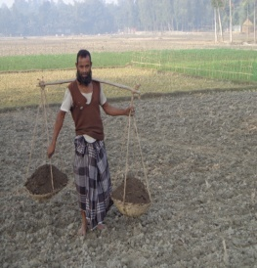
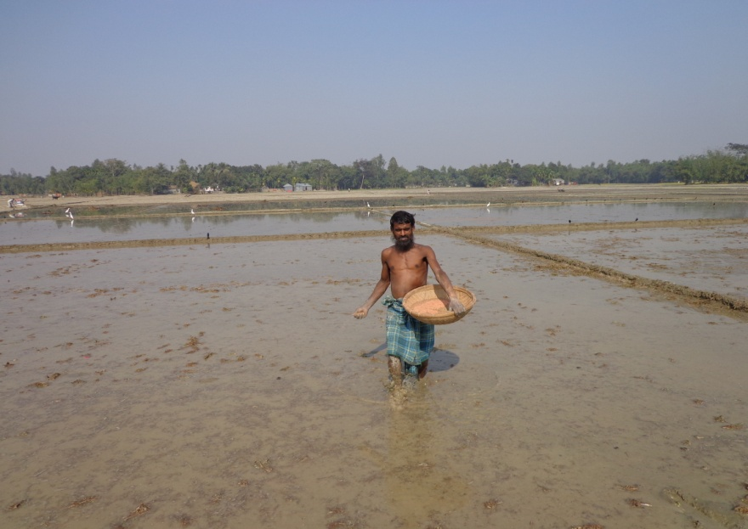
4. Application of organic fertilizer
SRI vs traditional methods: 6 key principles
SRI
Traditional Method
Use more organic fertilizer
Mainly use synthetic chemical fertilizers

Slide 10
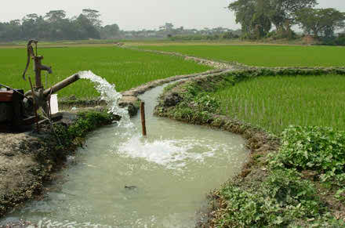
5. Alternate wetting and drying of rice fields
SRI vs traditional methods: 6 key principles
SRI
Traditional Method
Alternate wetting and drying
Continuously flooded

Slide 11
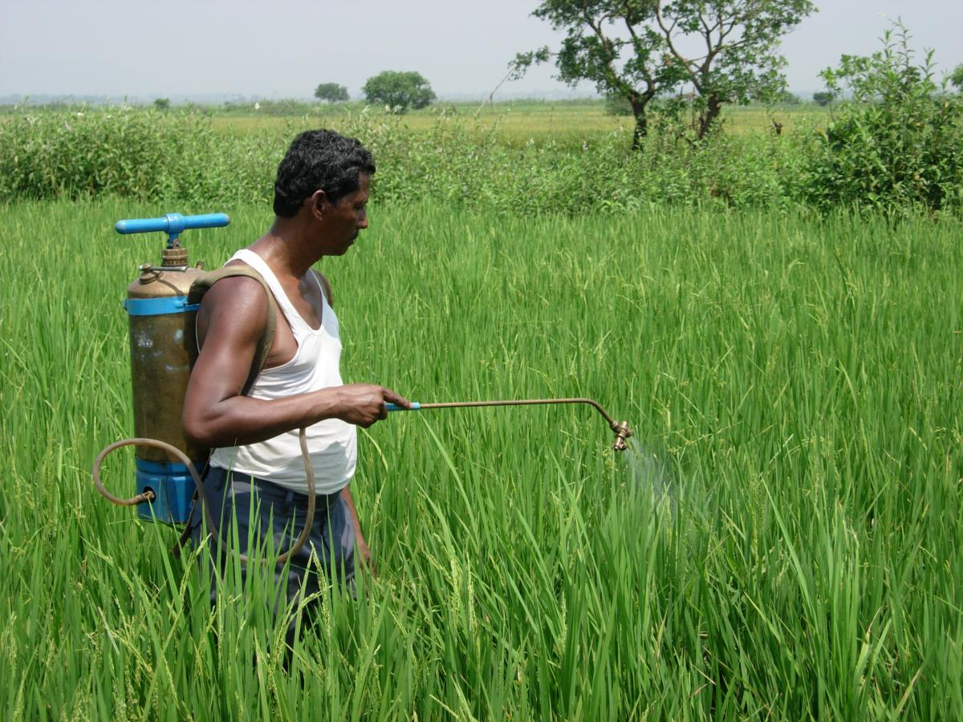
6. Regular mechanical weeding
SRI vs traditional methods: 6 key principles
SRI
Traditional Method
Mechanical weeding
Use pesticides

Slide 12
Multi-year RCT w/randomized saturation
Partnered with BRAC to implement across five different districts of rural Bangladesh
Randomized invitations to one-day SRI training course (w/standardized video module) offered by BRAC to rice farmers in rural Bangladesh, following RS design
Follows BRAC standard SRI curriculum for SRI, ensuring external validity for BRAC.
Repeated training in randomly selected half of training villages in second year.
Baseline, midline, endline survey data collection at end of Boro season along with direct observation of rice plots early in Boro season to establish compliance with SRI principles as trained.
Key outcomes: Adoption of SRI; rice yields, costs, profits; household well-being indicators

Slide 13
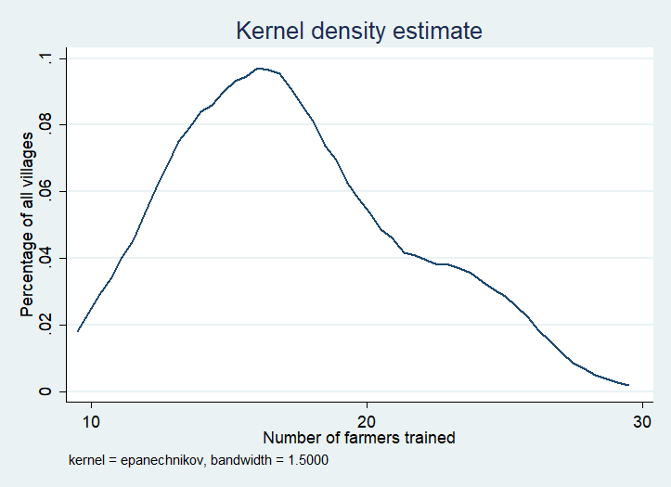
Experimental Design w/BRAC in rural Bangladesh
120 training villages
w/randomized saturation
62 control villages
1,856 farmers (C)
Randomized saturation
T1: 60 villages
Only one year of training
1,060 farmers trained (T1)
745 farmers untrained (U1)
T2: 60 villages
Two years of training
1,166 repeat trained (T2)
659 farmers untrained (U2)
30-40 farmers surveyed in each village. Number invited to training varied randomly by village between 10 and 30.
2,226 farmers trained, 1,404 untrained in training villages, 1,856 pure controls. Baseline (endline) sample = 5,486 (4,126)
No differential attrition across treatment arms.

Slide 14
Sample and Data
Treatment status | No. of Villages | Total baseline farmers | Total midline (2014-15) farmers | Total endline (2015-16) farmers
Control (C) | 62 | 1856 | 1663 | 1459
1 year training villages | 60 | 1805 | 1646 | 1313
Trained farmers (T1) |  | 1060 | 993 | 806
Untrained farmers (U1) |  | 745 | 653 | 507
2 year training villages | 60 | 1825 | 1625 | 1354
Trained farmers (T2) |  | 1166 | 1051 | 892
Untrained farmers (U2) |  | 659 | 574 | 462
Total | 182 | 5486 | 4934 | 4126
Large sample, across multiple years
Easily meets balance tests in all dimensions … design well implemented.
Attrition around 10% per annum, w/some variation across treatment arms.
But no evidence that treatment differentially predicts attrition.

Slide 15
Balance between Treatment and Control
Baseline characteristics of farmers by treatment status
p-values from joint nulls
0.59
0.63
0.89
0.42
Panel A | Treat |  | Control |  | p-value
Household Characteristics | Mean | Std.dev | Mean | Std.dev
Average Age of the household (above 15 years) | 36.75 | 0.13 | 36.43 | 0.18 | 0.14
Average Education of the adult member of household (years) | 4.31 | 0.04 | 4.34 | 0.06 | 0.67
Farm size (cultivable) last Boro season (in decimals) | 163.46 | 2.66 | 165.93 | 2.94 | 0.57
Household size | 5.13 | 0.03 | 5.19 | 0.05 | 0.25
Maximum education by any household member | 8.51 | 0.06 | 8.66 | 0.09 | 0.14
Yield (kg/decimal) | 22.28 | 4.84 | 22.44 | 5.50 | 0.12
Total cost of production | 430.26 | 250.44 | 422.64 | 224.44 | 0.10
Estimated profit | 440.12 | 255.93 | 445.42 | 341.81 | 0.34
No. of observations | 3630 |  | 1856
 | Treatment Villages Only
Panel B | Treated |  | Untreated |  |  | p-value
Household Characteristics | Mean | Std.dev | Mean | Std.dev
Average Age of the household (above 15 years) | 36.82 | 0.16 | 36.69 | 0.21 |  | 0.61
Average Education of the adult member of household (years) | 4.34 | 0.05 | 4.29 | 0.07 |  | 0.59
Farm size (cultivable) last Boro season (in decimals) | 161.47 | 2.99 | 166.40 | 4.97 |  | 0.37
Household size | 5.11 | 0.04 | 5.19 | 0.05 |  | 0.25
Maximum education by any household member | 8.54 | 0.07 | 8.52 | 0.10 |  | 0.85
Yield (kg/decimal) | 22.35 | 4.88 | 22.17 | 4.78 |  | 0.13
Total cost of production | 427.63 | 242.69 | 434.77 | 263.54 |  | 0.23
Estimated profit | 441.22 | 255.92 | 438.23 | 256.42 |  | 0.62
No. of observations | 2226 |  | 1404

Slide 16
Balance between Treatment and Control
Characteristics of trained farmers by number of treatment rounds
 | Treatment Villages Only
Variables of Interest | One-time Training Village (T1) |  | Two-time Training Village (T2) |  | p-value
Panel A; Household Characteristics (Baseline) | Mean | Std.dev | Mean | Std.dev
Average Age of the household (above 15 years) | 36.44 | 0.24 | 36.97 | 0.23 | 0.11
Average Education of the adult members (years) | 4.34 | 0.08 | 4.30 | 0.07 | 0.72
Farm size (cultivable) last Boro season (in decimals) | 167.66 | 4.61 | 164.61 | 4.67 | 0.64
Household size | 5.23 | 0.06 | 5.08 | 0.06 | 0.09
Maximum education by any household member | 8.64 | 0.12 | 8.45 | 0.11 | 0.21
No. of Observations (farmers) | 928 |  | 1003
Panel B: Yield, Cost and Profit (Baseline)
Yield (kg/decimal) | 22.42 | 4.69 | 22.28 | 5.05 | 0.30
Total cost of production | 425.06 | 239.55 | 430.06 | 245.64 | 0.47
Estimated profit | 445.38 | 256.77 | 437.31 | 255.11 | 0.27
Panel C: Yield, Cost and Profit (Midline)
SRI Adoption | 49.72 | 50.01 | 49.19 | 50.00 | 0.72
Yield (kg/decimal) | 26.28 | 7.43 | 26.06 | 6.87 | 0.29
Total cost of production | 315.71 | 112.61 | 310.89 | 111.75 | 0.14
Estimated profit | 526.93 | 243.37 | 530.63 | 236.78 | 0.60

Slide 17
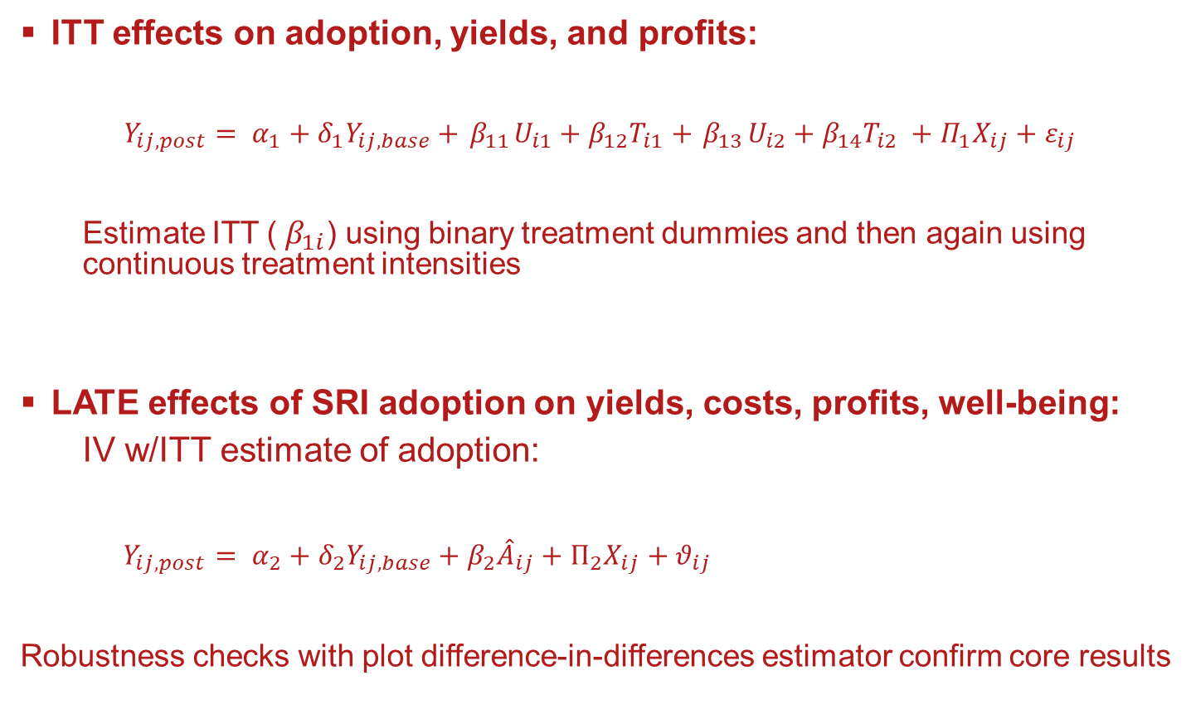
Core empirical strategy: hh-level ANCOVA
ITT effects on adoption, yields, and profits:
$$Y_{ij,post}= α_{1}+δ_{1}Y_{ij,base}+{ β}_{11}U_{i1}+{β_{12}T}_{i1}+{ β}_{13}U_{i2}+{β_{14}T}_{i2} +Π_{1}X_{ij}+ε_{ij}$$
  Estimate ITT (${ β}_{1i}$) using binary treatment dummies and then again using continuous treatment intensities
LATE effects of SRI adoption on yields, costs, profits, well-being:
  IV w/ITT estimate of adoption:
$Y_{ij,post}= α_{2}+δ_{2}Y_{ij,base}+β_{2}{\hat{A}}_{ij}+Π_{2}X_{ij}+θ_{ij}$
Robustness checks with plot difference-in-differences estimator confirm core results

Slide 18
Endline ITT estimates by treatment category
SRI training has positive and significant adoption effects across the board
Strong social spillover effects on untreated farmers in training villages
ITT effects on adoption increasing in intensity of exposure (C<U1<U2<T1<T2)
ITT effects on outcomes statistically indistinguishable among treatment arms
 | % SRI Adoption | Yield | Revenue | Total cost | Profit
One-time untreated (U1) | 8.608*** | 0.180*** | 0.210*** | 0.111* | 0.386***
One-time treated (T1) | 31.296*** | 0.174*** | 0.204*** | 0.146** | 0.403***
Two-time untreated (U2) | 8.625*** | 0.203*** | 0.234*** | 0.167*** | 0.462***
Two-time treated (T2) | 42.047*** | 0.226*** | 0.249*** | 0.184*** | 0.482***
Baseline outcome |  | 0.260*** | 0.249*** | 0.076* | 0.362***
Observations | 10,286 | 8,626 | 8,626 | 8,626 | 8,626
p-value (U1-T1) | 0.00 | 0.78 | 0.76 | 0.20 | 0.81
p-value (U1-U2) | 0.99 | 0.44 | 0.48 | 0.27 | 0.66
p-value (T1-T2) | 0.09 | 0.07 | 0.20 | 0.50 | 0.67
p-value (U2-T2) | 0.00 | 0.19 | 0.43 | 0.68 | 0.87
Results qualitatively identical using continuous treatment intensity and w/plot-level diff-in-diff.

Slide 19
Nonlinear exposure intensity effects
ITT treatment intensity effect emerges > median (0.6) saturation
Entirely saturation effects among trainees in once-trained villages … more saturated one-shot training impact equiv to less saturated repeated training.
More consistent with social conformity than w/social learning effects.
ITT Treatment Intensities | % SRI Adoption
One-time untreated (U1F) | 14.942***
U1F x > 70% | 4.226
One-time treated (T1F) | 49.383***
T1F x > 70% | 25.145***
Two-time untreated (U2F) | 12.983**
U2F x > 70% | 12.329
Two-time treated (T2F) | 73.278***
T2F x > 70% | -12.320
Observations | 10,286
Adjusted R² | 0.232

Slide 20
LATE estimates of effects of SRI adoption
Using the ITT estimate of SRI adoption as a first stage in the IV, we find:
SRI has a positive causal impact on rice yields, costs and profits, consistent w/observational literature.
The effects are BIG!
 | Yield | Revenue | Total cost | Profit
Adopted SRI (IV=Treatment status) | 0.369*** | 0.408*** | 0.324*** | 0.821***
Baseline outcome | 0.321*** | 0.308*** | 0.122*** | 0.430***
1st stage F stats all >50. Results qualitatively same under continuous treatment and plot diff-in-diff.

Slide 21
ITT/ LATE estimates of effects on household well-being
Positive ITT and LATE estimates of impacts on various household well-being measures, esp. for directly trained and for savings. ITT effects again invariant to intensity of exposure.
Technology has favorable well-being impacts, at least for direct trainees.
Panel A: ITT (Treatment Status) | Ln(Savings)ª | Household status | Food security | Life satisfaction | Satisfaction with living standard
One-time untreated (U1) | 0.573** | 0.157 | 0.051 | 0.212 | 0.147
One-time treated (T1) | 0.276** | 0.101 | 0.327** | 0.311** | 0.244*
Two-time untreated (U2) | 0.627** | 0.031 | 0.172 | 0.095 | 0.104
Two-time treated (T2) | 0.359** | 0.190** | 0.249 | 0.209 | 0.222**
Baseline outcome | 0.029** | 0.420*** | 0.055 | 0.069*** | 0.064***
p-value (U1-T1) | 0.25 | 0.56 | 0.01 | 0.26 | 0.39
p-value (U1-U2) | 0.88 | 0.35 | 0.42 | 0.44 | 0.77
p-value (T1-T2) | 0.65 | 0.32 | 0.61 | 0.34 | 0.85
p-value (U2-T2) | 0.27 | 0.06 | 0.51 | 0.26 | 0.25
Panel B: LATE
Adopted SRI (IV=Treatment status) | 0.228 | 0.321* | 0.681*** | 0.496** | 0.435**
Baseline outcome | 0.028* | 0.414*** | 0.061 | 0.085*** | 0.074***
21 SRI Bangladesh March 2020

Slide 22
Any GE effects?
One might naturally worry about general equilibrium impacts on labor and/or rice markets.
Use randomized saturation rates to check.
No wage rate effects. Rice price effects, if any, appear negative, reinforcing results.
 | Village wage rate |  | Village rice price
 | Midline | Endline | Midline | Endline
Fraction of village sample trained | 22.865 | -19.761 | -0.362 | -1.084*
 | (20.505) | (12.241) | (0.477) | (0.589)
Observations | 120 | 120 | 120 | 120
Adjusted R² | 0.244 | 0.233 | 0.657 | 0.223
22 SRI Bangladesh March 2020

Slide 23
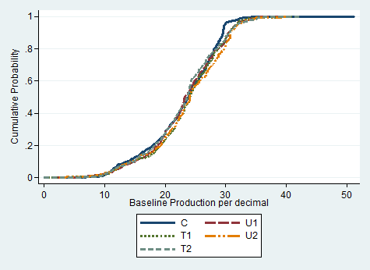
Insights from non-random selection into SRI uptake
No stochastic dominance b/n C&T at baseline.
FOSD at midline (and continues at endline), but no dominance among treatment arms.

Slide 24
Insights from non-random selection into SRI uptake
If unobservables (e.g., skill) complement the technology and both positively affect productivity, then uptake will be non-random.
If beliefs updating is a function of both intensity of exposure and expected outcome, then initial adoption will be by farmers who expect to benefit more.
Exposure intensity generates a clear scaling effect but negligible productivity effect.
Ordered endline profits by treatment status
Ordered endline yields by treatment status

Slide 25
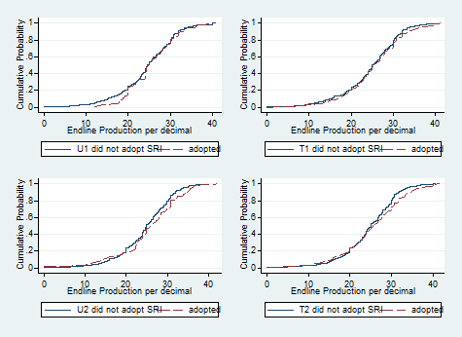
Insights from non-random selection into SRI uptake
No stochastic dominance at endline b/n adopters and non-adopters w/n treatment groups.
P-values decreasing w/
exposure intensity as
adherence to training
weakly improves w/
exposure intensity.
But farmers make reasonably
rational SRI uptake decisions
w/n each treatment group.

Slide 26
Disadoption and Delayed Adoption of SRI
SRI use rate stable at 32-33% in both years
36% of farmers who adopted in year 1 disadopted SRI in year 2, replaced by 18% of initial non-adopters who adopt w/delay.
Intensity of exposure to SRI training impacts adoption, disadoption and delayed adoption following the same pattern as endline adoption.
SRI Adoption End of Year 1 | SRI Adoption end of Year 2 |  | Total
 | Did not Adopt | Adopted
Did not Adopt | (Never adopters) 1475 (82.36%) (U1=448, T1=308, U2=386, T2=333) | (Delayed adopters) 316 (17.64%) (U1=29, T1=101, U2=42, T2=144) | 1791 67.15%
Adopted | (Disadopters) 317 (36.19%) (U1=16, T1=189, U2=21, T2=91) | (Persistent adopters) 559 (63.81%) (U1=14, T1=208, U2=13, T2=324) | 876 32.85%
N % | 1792 67.19% | 875 32.81% | 2667 100%

Slide 27
Disadoption and Delayed Adoption of SRI
Disadopters:
Relatively older and less educated, with more land.
Had highest midline cost of production.
Experienced smaller gain in profits (29%) compared to the persistent adopters (53%) at the end of year 1.
Delayed Adopters:
Had lower production at the end of year 1 (24.9 kg/decimal) than persistent adopters (26.1 kg/decimal).
Never Adopters:
At baseline: significantly lower cost of production and higher profits and better off than adopters.
Possibly had little (least?) to gain from adoption of the SRI.
Persistent Adopters:
Had largest (smallest) midline-baseline Δprofits (Δ costs)

Slide 28
Conclusions
Higher intensity of SRI training exposure in both cross-section and time series has big diffusion effect, positive on uptake, negative on disadoption.
Exposure to SRI training also has significant, positive effects on rice yields and profits and hh well-being.
LATE of SRI adoption on rice yields (37%) or profits (82%) and household well-being outcomes are consistently positive and relatively large.
Highly non-random selection-on-unobservables into SRI adoption. Exposure mainly has a scaling effect.
However, also high rates of disadoption, limited adherence to principles as taught, and only very modest adjustment of practices in response to more experience/training.
Patterns not consistent w/ target input learning models: much disadoption and negligible improvement in performance with added information exposure. Consistent w/ newer models of multi object learning and selective, rational inattention. Farmers seem to learn to whether to use SRI more than how to use SRI.

Slide 29
Thank you for your interest!
We invite your comments and questions:
Chris Barrett – cbb2@cornell.edu

